Slide 1

Insider Stock Transactions
A deep dive into q3 2024 data

Slide 2
Who is an Insider?
“The federal securities laws require certain individuals (such as officers, directors, and those that hold more than 10% of any class of a company’s securities, together we’ll call, “insiders”) to report purchases, sales, and holdings of their company’s securities by filing Forms 3, 4, and 5. (1)”
Transactions are published 2 days after the trade occurs
I have looked at data as filed in 2024 Q3 with the SEC through EDGAR filings. I have only looked at Form 4 submissions for companies contained in SP500.
Notes:
(1) Updated Investor Bulletin: Insider Transactions and Forms 3, 4, and 5 | Investor.gov

Slide 3
What might we glean from this dataset?
Which insiders and stocks have been trading?
Which stocks have been the most sold or bought by insiders?
Is there a pattern in when insiders buy or sell?
Stock Price Impact
Are there any patterns in when insiders transact?
Is there any noticeable market impact on announcement of insider transactions?
    Potentially rally on buy
    Potentially sell-off on sell

Slide 4
Data Processing- EDGAR data
Submissions
Yfinance:
S&P500 & Stock prices
Non_Deriv_Transactions
Kaggle:
S&P 500 names
Reporting Owner
Notes:
(1) Updated Investor Bulletin: Insider Transactions and Forms 3, 4, and 5 | Investor.gov

Slide 5
Data Processing- EDGAR data
55,881
Data set selection
  Only companies in SP500
    Limit stock prices to be pulled
  Only transactions which were of type P or S
    (purchase or sale of securities on an exchange or from another person)
    These are selected as they are the only ones that would have direct market impact
  Only transactions from form 4
    Normal buys or sells NOT late filing(form 5) or new insider forms (form 3)
    Limiting to transactions with potential market impact
  Only transactions occuring within the Q3 period (late submissions removed)
    Limiting to transactions with potential market impact
11,422
5,669
5,668
5,629
Notes:
(1) Updated Investor Bulletin: Insider Transactions and Forms 3, 4, and 5 | Investor.gov

Slide 6
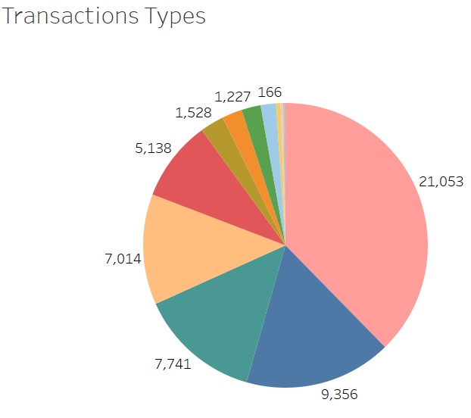
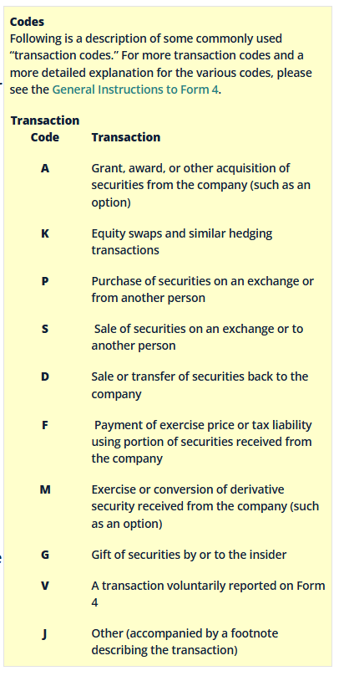
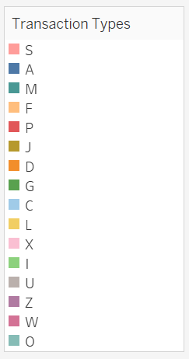
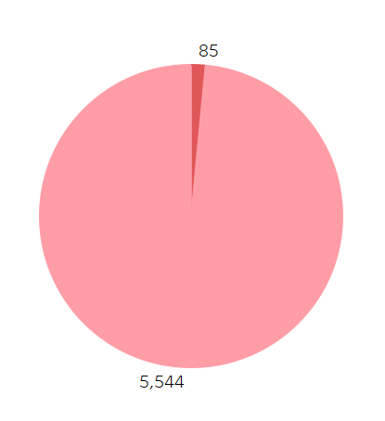
Transaction Type Findings
  The large majority of insider trades were sells during Q3
  The next 2 most common were insiders recieving shares from the company in the form of either outright stocks or in options format
  Next was sells to pay taxes or to exercise options
  Finally next were outright buys
  However, most of those buys were in non- S&P500 companies
  Thoughts
  It looks like most sells are potentially shares recieved from the company as compensation
  S&P 500 insiders are less likely to outright buy their own company shares
Notes:
(1) Updated Investor Bulletin: Insider Transactions and Forms 3, 4, and 5 | Investor.gov

Slide 7
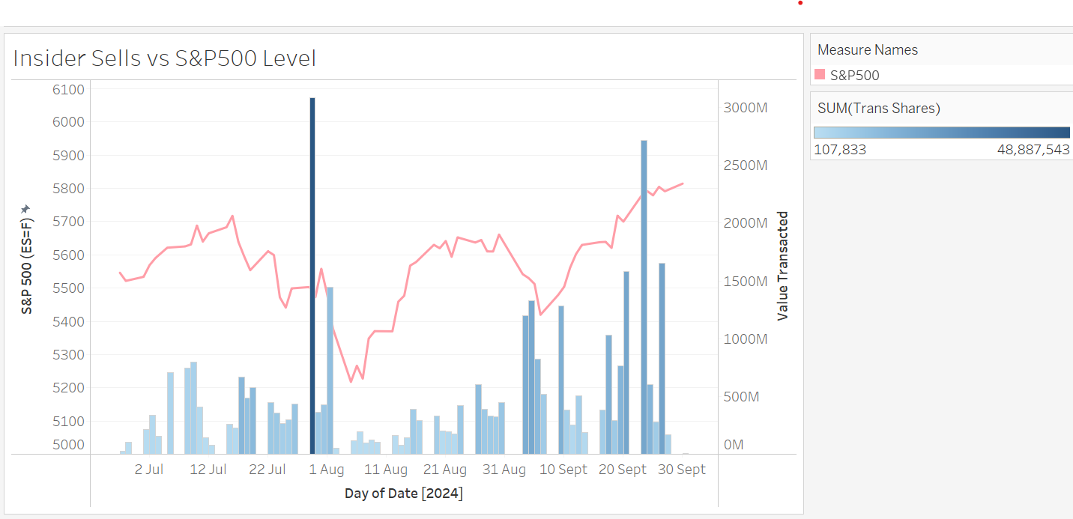
Insider Sells over the Quarter
  Findings
    The largest days for selling were the 29 July and 23 Sept
    On the 29th July, both the value and quantity of stocks sold were the highest
    There does seem to potentially be some weakness in the market after sells but it is hard to tell
Notes:
(1) Updated Investor Bulletin: Insider Transactions and Forms 3, 4, and 5 | Investor.gov

Slide 8
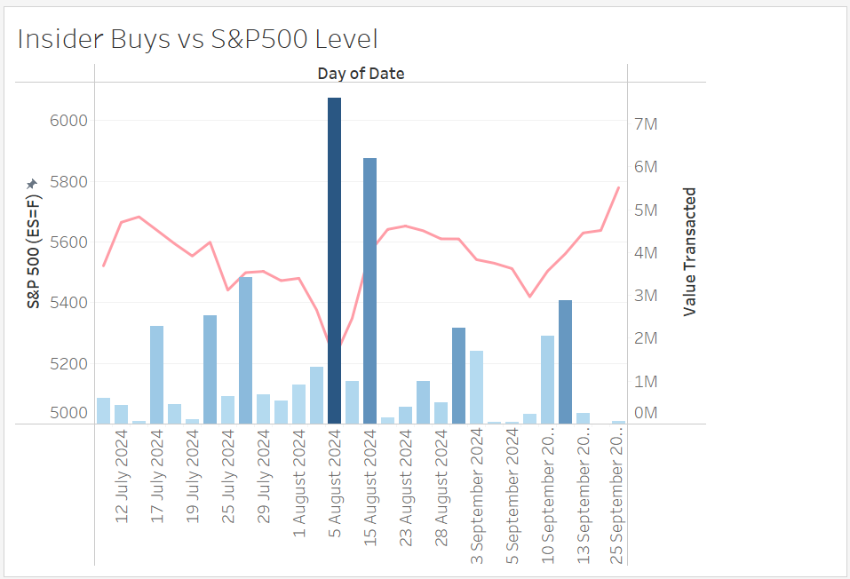
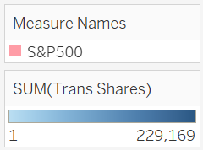
Insider Buys over the Quarter
  Findings
    The value transacted here varies from 0-10Mio USD range
      This compares to the 0-3Bil USD range for sells!!!
    Insiders did purchase shares mostly after the mini-crash we had on the 4th of August
    Potentially buying is a more ’Active’ choice where as maybe selling is a response to recieving shares from the company
Notes:
(1) Updated Investor Bulletin: Insider Transactions and Forms 3, 4, and 5 | Investor.gov

Slide 9
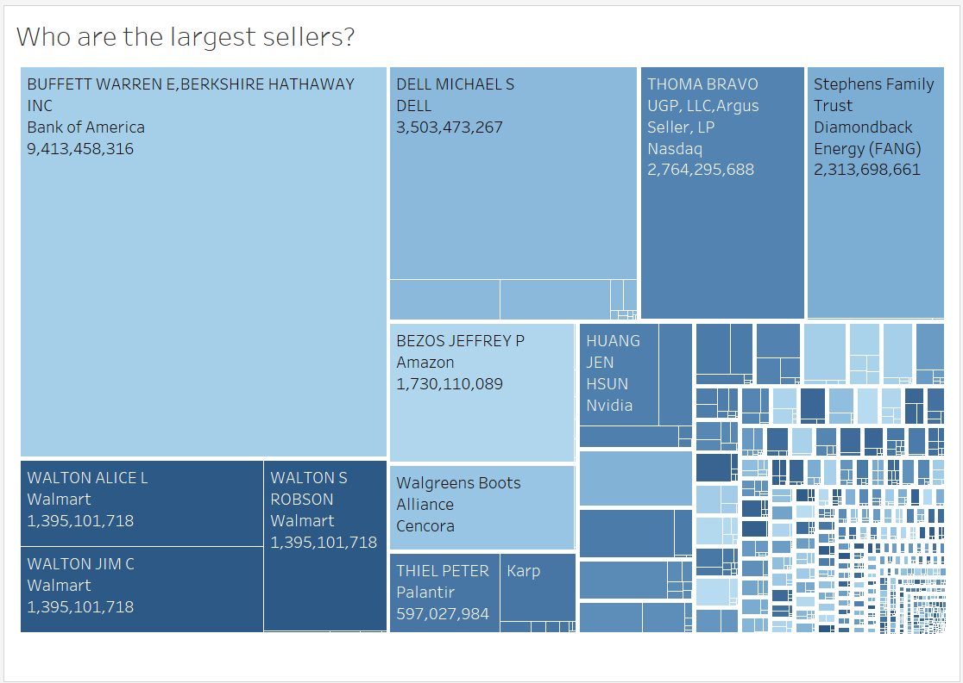
Who is selling?
  Findings
    The biggest seller is Warren Buffett of Bank of America.
      He is an insider because he is more than 10% owner via Berkshire Hathaway
    There is speculation in market why his is aggressively divesting (2)
    It seems all of these are flagged in the market two days after the transaction when they are reported as I can find news articles. However, they don’t seem to necessarily be aggregating the buys or sells over time.
Notes:
https://www.fool.com/investing/2024/10/30/warren-buffett-sold-26-bofa-piling-into-33000-ipo/

Slide 10
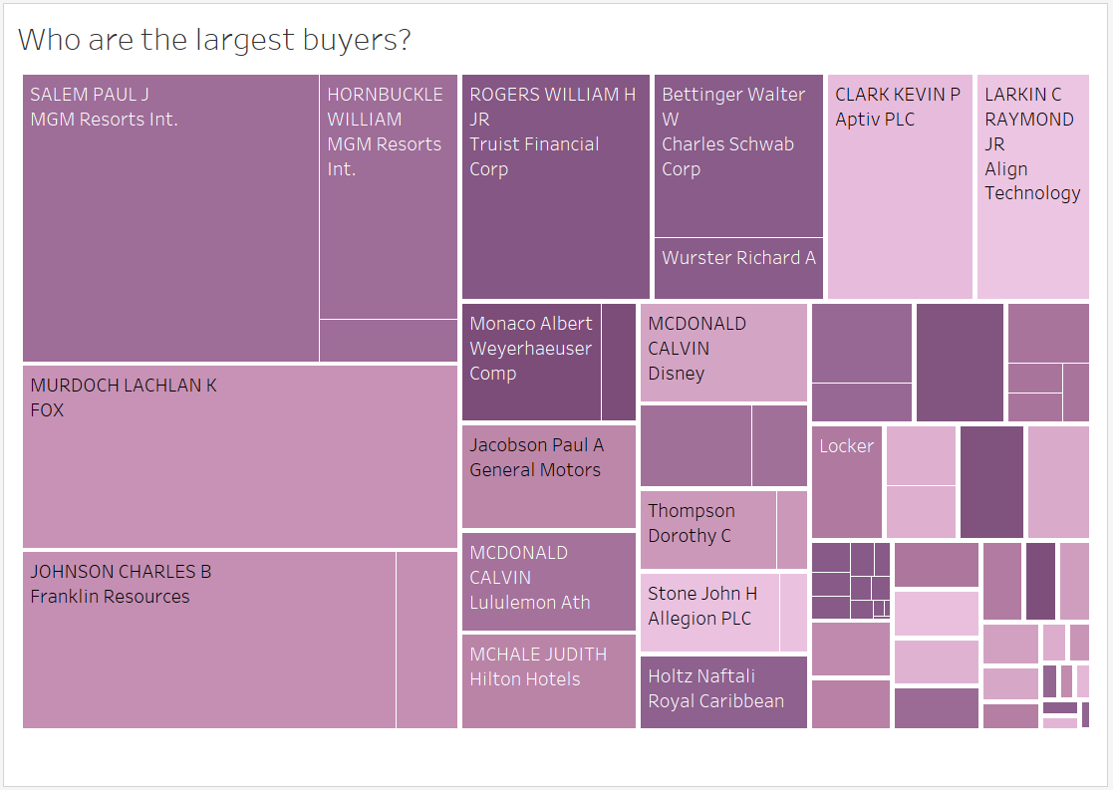
Who is buying?
  Findings
    The biggest buyer is Paul Salem (MGM), followed by Lachlan Murdoch (FOX) and Charles Johnson (Franklin Resources)
    Similar to the sells, there are news articles about most of these buys
Notes:
https://www.fool.com/investing/2024/10/30/warren-buffett-sold-26-bofa-piling-into-33000-ipo/

Slide 11
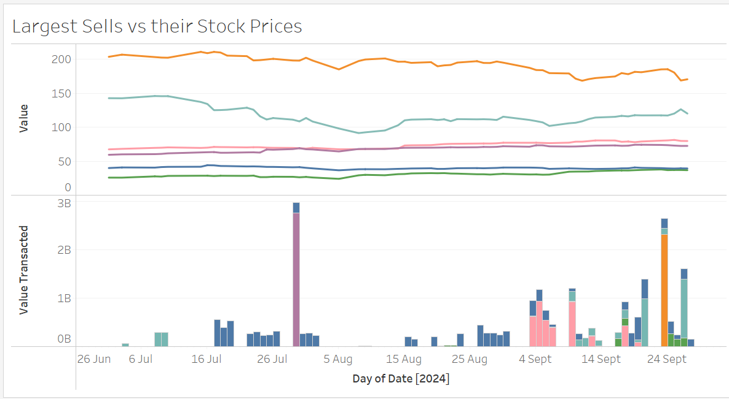

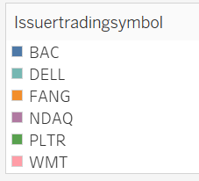
Sells over 1 Billion USD over time
  Findings
    Berkshire Hathaway spread his sells of Bank of America out over time, whereas the sell of Nasdaq was all done in one block trade
    It is hard to tease out whether these sells had any impact on the individual stock prices

Slide 12
Stock Returns Study
To get a better picture of the impact of buys and sells on the stock price i transformed the data further into stock returns, so that they could be aggregated further
All stock transactions in one stock on a day were aggregated and considered to be 1 transaction rather than 1 for each individual trade
I looked at it as if it were an event study
  Event Occurs: a buy or sell of the stock at a point T in time
  Impact on: returns (percentage change in the stock price) on the days after the transaction
I also made a control group to compare the returns on the stock in another randomly selected time (and the 5 days after)
Notes:
(1) Updated Investor Bulletin: Insider Transactions and Forms 3, 4, and 5 | Investor.gov

Slide 13

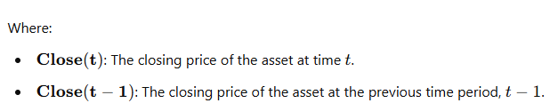
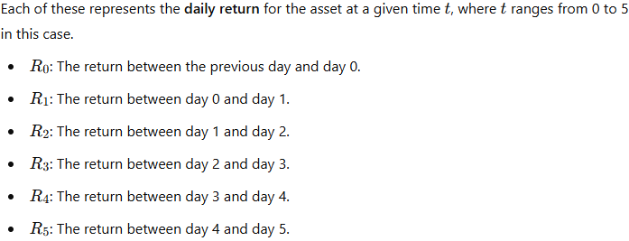
Data Processing- Returns Study
  Transaction occurs here
  First I line up the stock prices so that their Close the day before the transaction sits in T-1; The Close price the day of the transactions sits in T+0 (and so forth.
  I then calculate returns for each day as defined:
  T-1 T+0 T+1 T+2 T+3 T+4 T+5
  This gets me:
  R0 R1 R2 R3 R4 R5
  Return on day transaction published
  Return on day stock transacted
Notes:
(1) Updated Investor Bulletin: Insider Transactions and Forms 3, 4, and 5 | Investor.gov

Slide 14
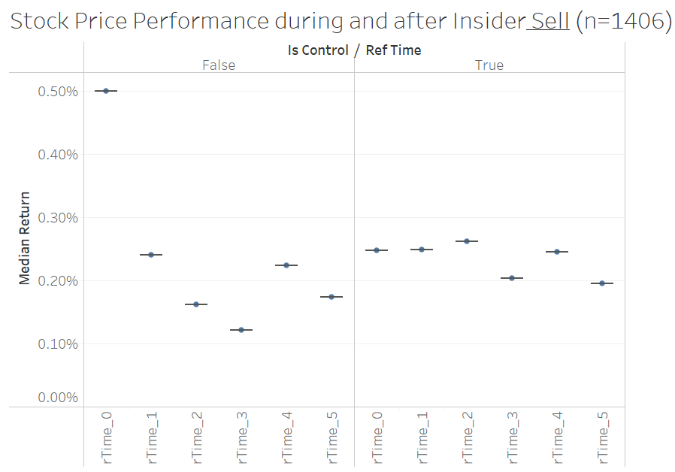
Returns Study Findings – Stock Sells
  I find that the returns on the day that insiders sell stocks are considerably higher than average. Insiders sell on days when the stock is rallying.
  Stock generally perform same as average on the day after the sell
  Stock look like they underperform the day that the sell transaction is published (t+2)
  Stocks also look to underperform the day after the announcement (t+3)
  The control group provides some indication of the what returns would look like without any ”news”
Notes:
(1) Updated Investor Bulletin: Insider Transactions and Forms 3, 4, and 5 | Investor.gov

Slide 15
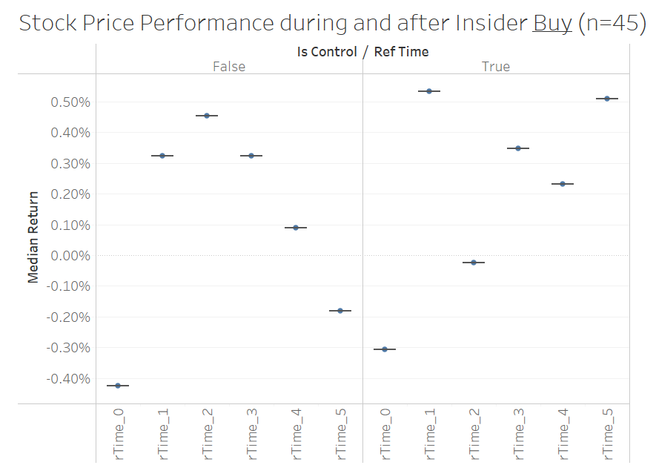
Stock Study Findings – Stock Buys
  There is considerably greater variability in the returns here due to the smaller number of studied transactions. This holds for both the transactions and the controls.
    This is probably due to the number but could also be a selection issue where insiders that are buying are working for more volatile companies
  Potentially the returns on the day that insiders buy are lower than average. Insiders buy when the stock has been selling off? However, this is harder case to make given the volatility of the control.
  Also, it does appear that returns are higher on day following announcement (t+2, t+3) but again hard to see clearly given the vol in returns.
Notes:
(1) Updated Investor Bulletin: Insider Transactions and Forms 3, 4, and 5 | Investor.gov

Slide 16
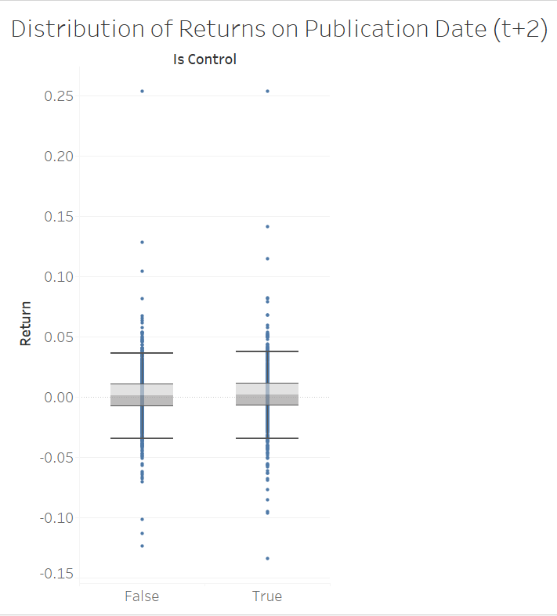
Stock Study- Mann-Whitney Test
We will focus on the sells since we have more data points there.
In order for us to have a trading strategy, we need to see if there is a trade to be made on t+2 when the sells are announced. As you can see on the right hand side there is a very large variance between returns for both groups. This would indicate that the risks of the trading strategy are high.
The Mann-Whitney ’Less’ test gave a p-value of 0.043 which means we can reject the null hypothesis. This means we can say the experiment return is less than the control return and that the difference is statistically significant.
In order for us to have a trading strategy, however we would need to look at lot of other factors including: if this relationship is consistent over time, the cost to transact, if our risk-adjusted return is sufficient etc.
Notes:
(1) Updated Investor Bulletin: Insider Transactions and Forms 3, 4, and 5 | Investor.gov

Slide 17
Conclusions
Which insiders / stocks have been trading?
Which stocks have been the most sold or bought by insiders?
  There have been considerably more sells than buys during this period. Potentially this is always the case as insiders divest stock awards.
  Warren Buffett has been the biggest seller of Bank of America followed by the Waltons selling Walmart
Is there a pattern in when insiders buy or sell?
  Potentially they are more active at month end and during days of high market volatility
Is there stock maket impact?
Are there any patterns in when insiders transact?
  Insiders seem to buy on days when the market has sold off and sell on days when the market has rallied.
Is there any noticeable market impact on announcement of insider transactions?
  Using a Mann-Whitney test we were able to conclude that on the day of announcement, returns were lower than the control group. However, we don’t believe there is trade to do here given costs and risks involved.
Notes:
(1) Updated Investor Bulletin: Insider Transactions and Forms 3, 4, and 5 | Investor.gov

